Slide 1

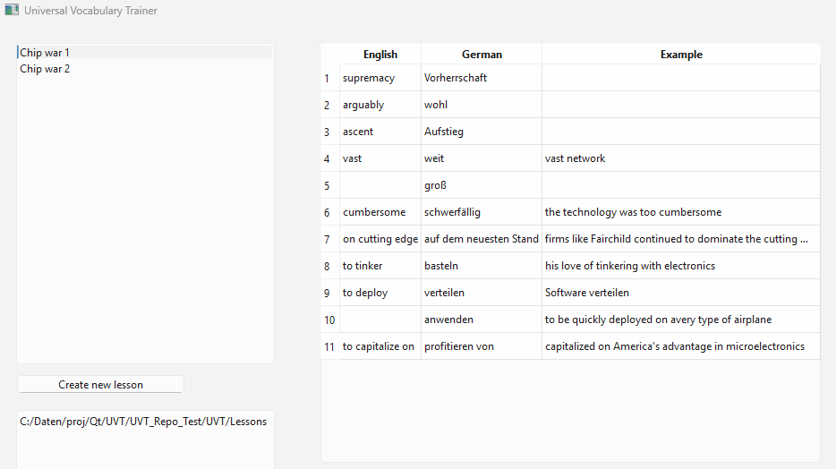
MainWindow
words
lessons
foreign
native
example

